Slide 1
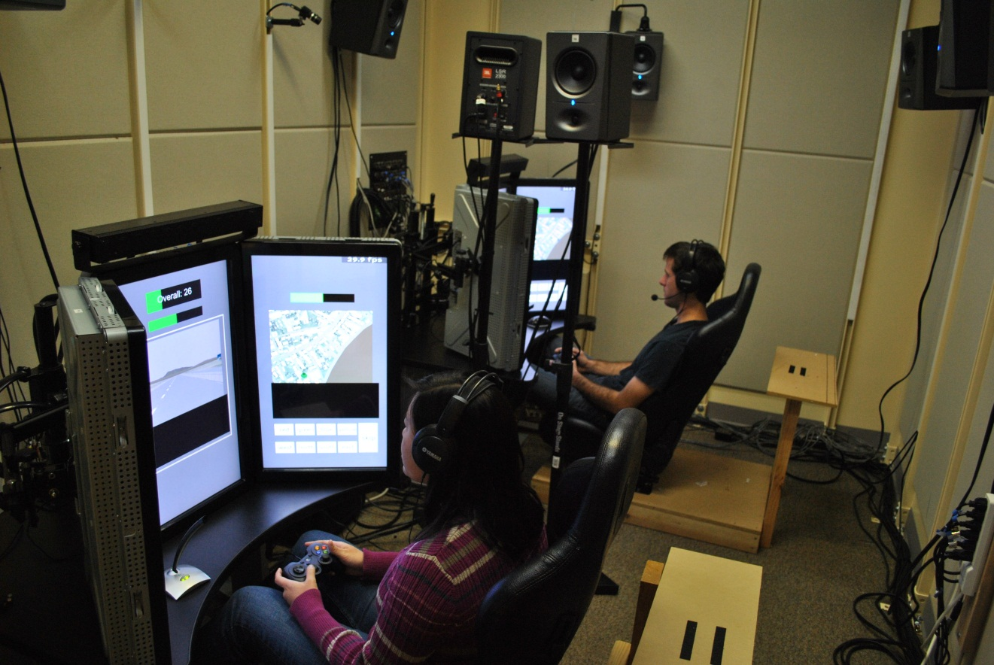
Welcome to STRUM!
Notes:
1

Slide 2
STRUM Tutorial
Outline
Game Design
Player Controls
Team Communication
Point System & Bonus Points
The Missions
The Side Tasks
The Alerting Task
Summary

Slide 3
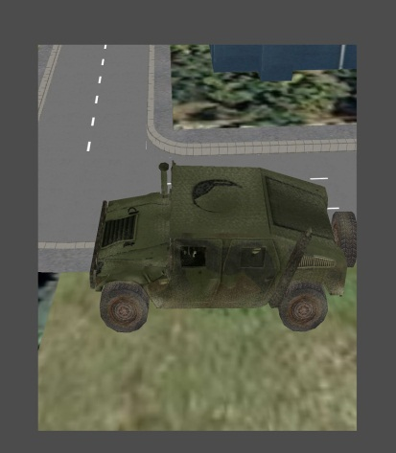
Game Design
STRUM - What is It?
STRUM stands for Small Team Reconnaissance and Urban Missions
The Game Story Line
You and your partner are a two-person reconnaissance and surveillance team placed within a command post humvee in a coastal city. Your code name is Delta or Echo. Seated in your vehicle command post, you will complete six primary missions, often in parallel with one or two of five different side tasks.
Inside
Humvee
Notes:
3

Slide 4
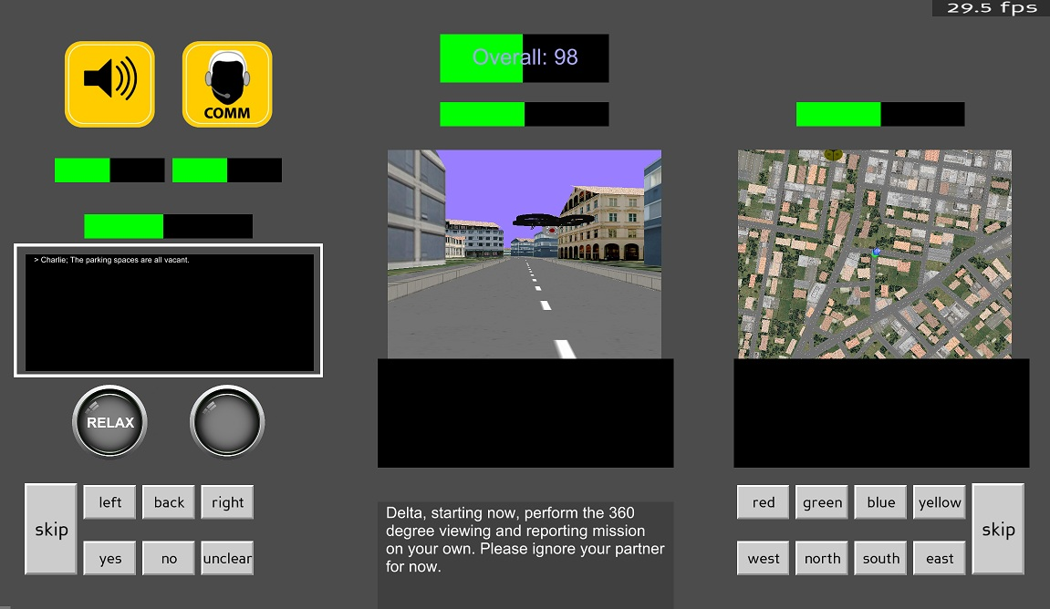
Game Design
3 LCD Touchscreens
1
2
3

Slide 5
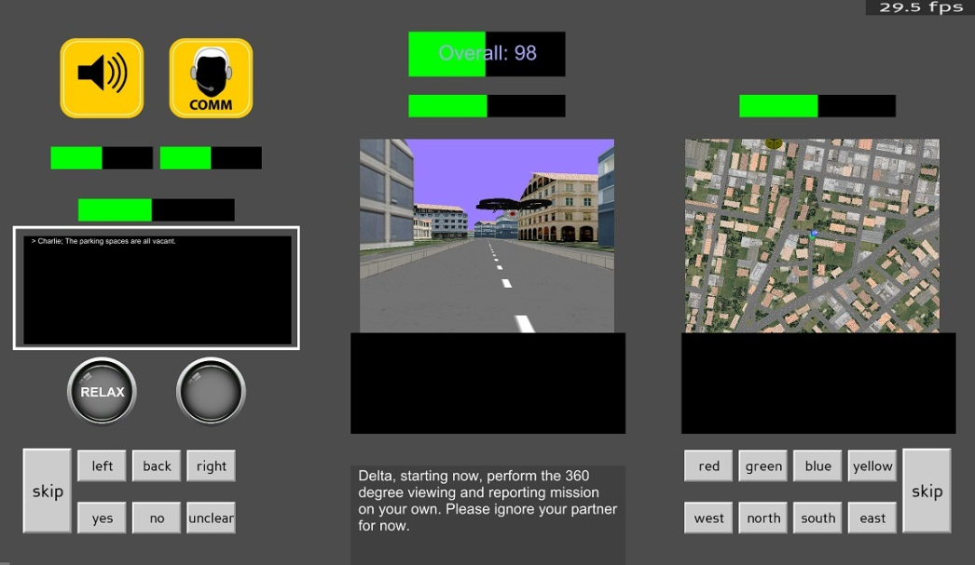
Game Design
Primary Missions
Located on center screen
Side Tasks
Located on all three screens
Notes:
5

Slide 6
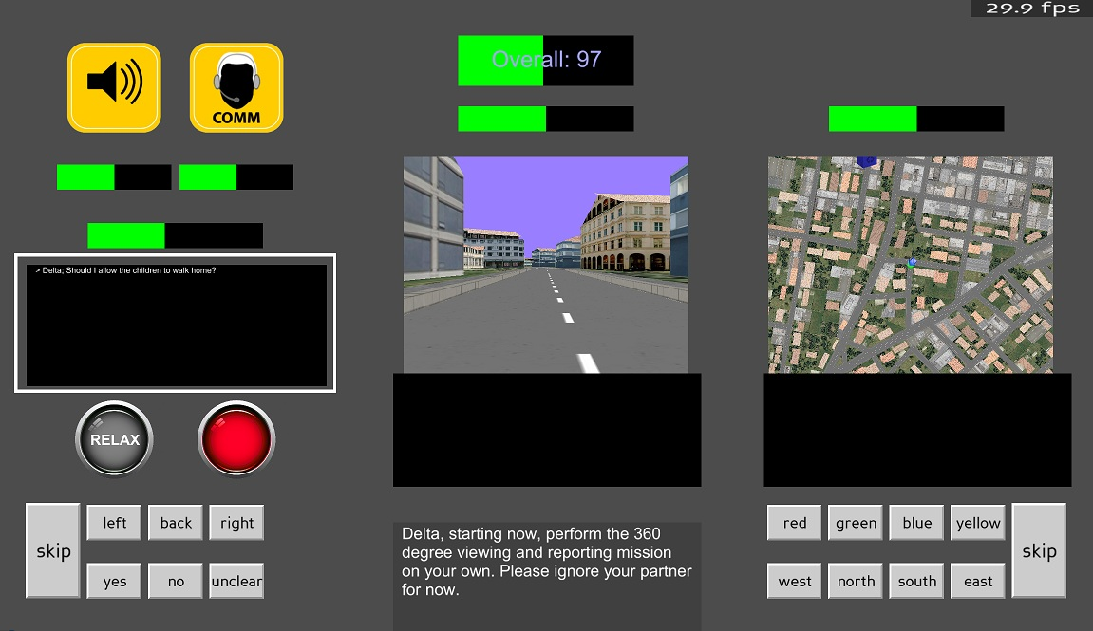

Alerting Tasks
WARNING BUTTON
Notes:
6

Slide 7
Game Design
Experiment Duration
Primary mission = 8 to 15 min
Several missions comprise 1 block = 45 to 60 minutes
Total game is 4 blocks* = 3 hours
There will be a brief bathroom and snack break halfway through the experiment if desired.
*Between the blocks, you will have rest states that last 3 to 4 minutes during which you are still being recorded. So please don’t move!

Slide 8
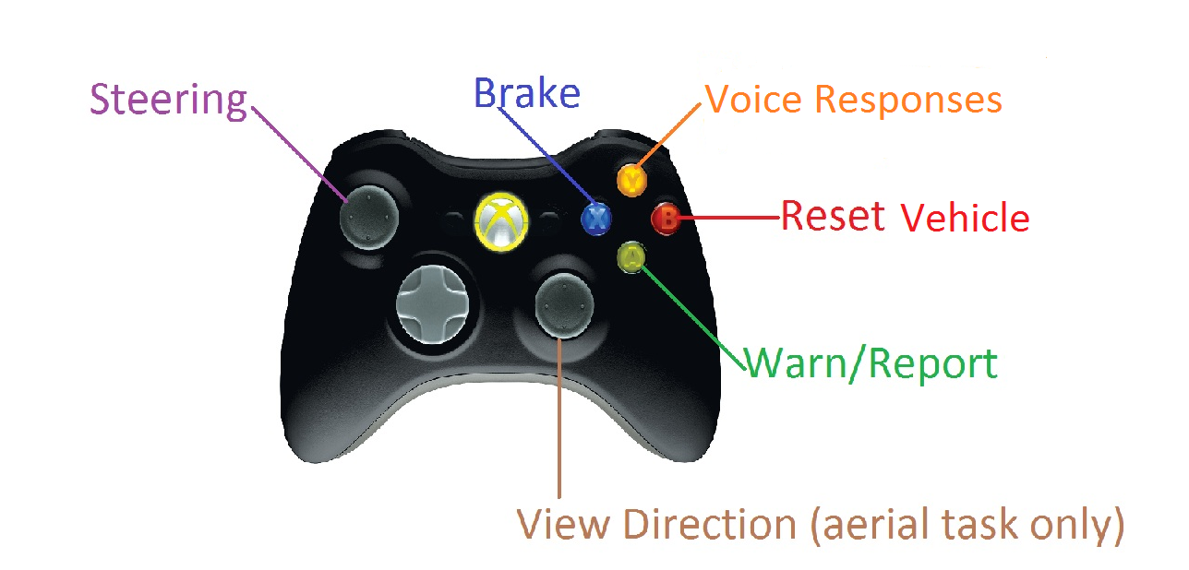
Player Controls
Notes:
8

Slide 9
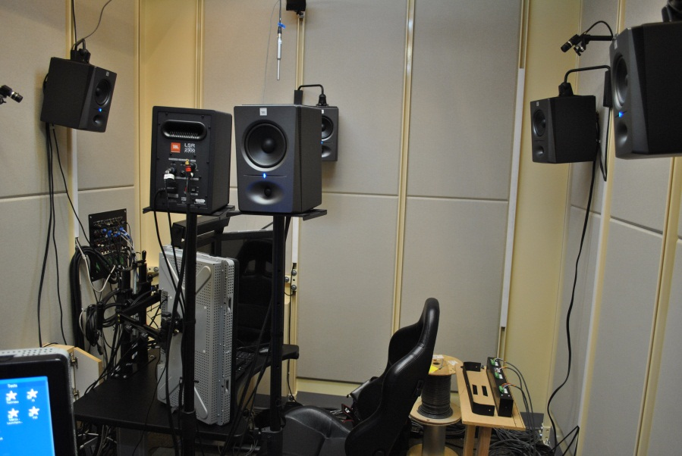
Team Communication
It’s important to communicate with your partner because players will not be able to see each other’s screens.
Notes:
9

Slide 10
Point System & Bonus Points
Overall Score Bar
Bonus depends on your overall score

Slide 11
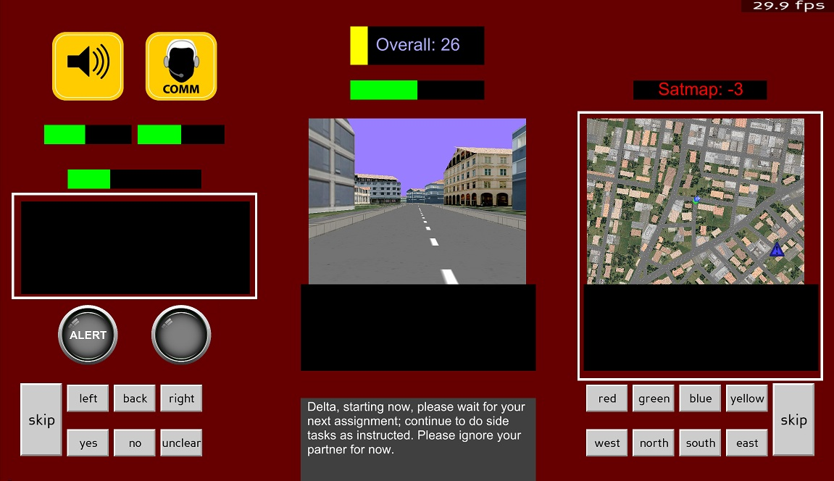
Point System & Bonus Points
Side Task Score Bars
Green means you are safe, yellow means you need to pay more attention, negative red points means you are grounded.

Slide 12
Point System & Bonus Points
Stress Mode
The screen turns red and there is a 4x multiplier to ALL points while in this mode.

Slide 13
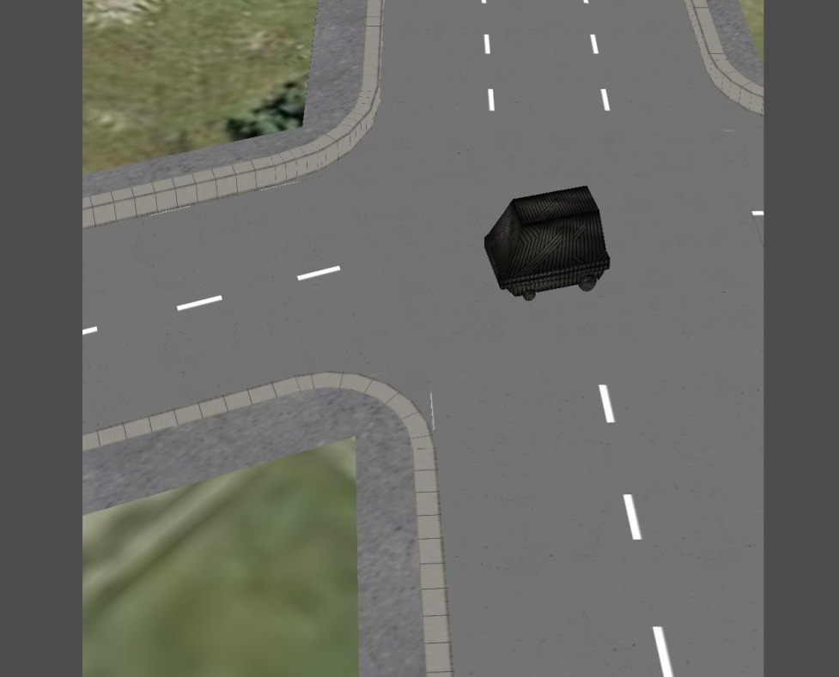

Missions
You and your partner control remote vehicles from a command post truck in a coastal city.
Each vehicle (ground or aerial) is equipped with a video camera that you will control in order to explore the city.

Slide 14
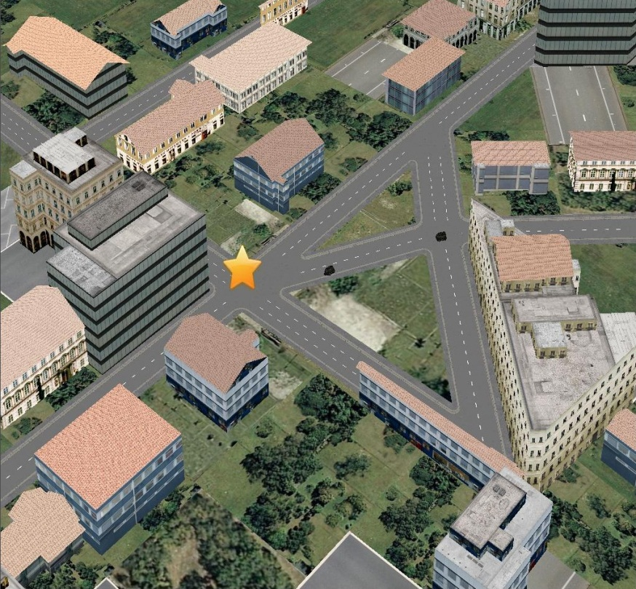
Missions 1 & 2 - Checkpoints
Tip: This task will be completed both individually or cooperatively partners.
Notes:
14

Slide 15

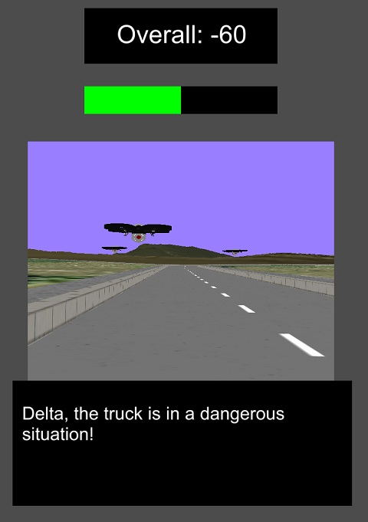
Mission 3 – Perimeter Defense
Example of Warning! sound ➔
Notes:
15

Slide 16
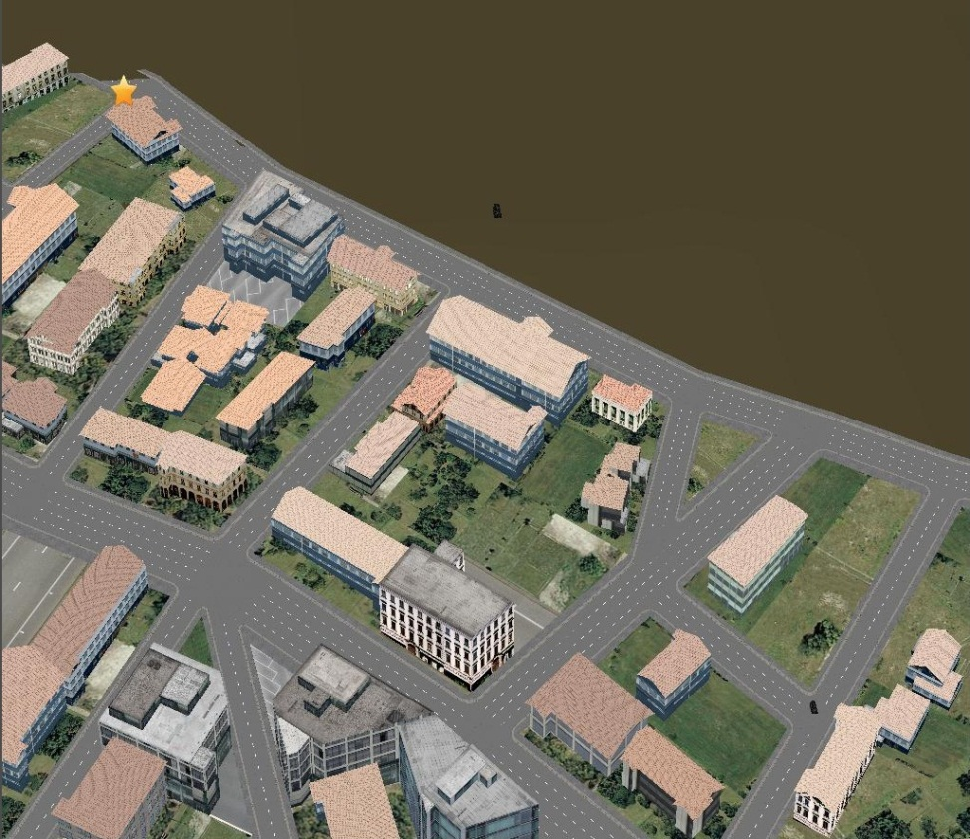
Mission 4 – Aerial Guidance
3. Checkpoint
1. Aerial Robot
Tip: Drones will be patrolling the streets and you will lose points if you’re spotted by one, so communication is key!
2. Ground Robot
Notes:
16

Slide 17
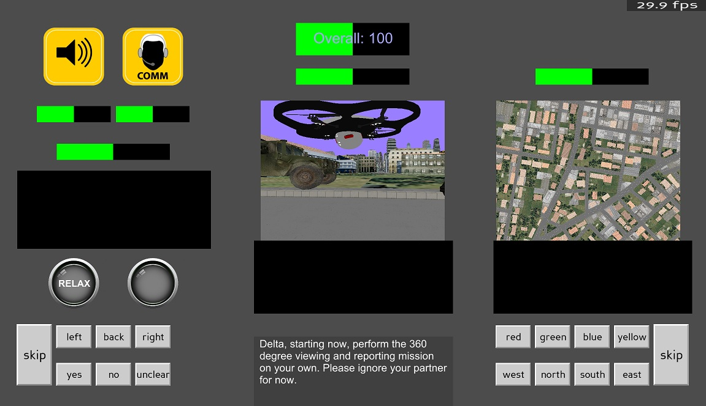
Mission 5 – Panning Surveillance
360°
Tip 1: You must face the drone when using the warning sound. You’ll be penalized for warning off a drone a second time before it leaves your sight. You’ll be penalized for failing to warn off a visible drone.
Tip 2: After successfully warning off a drone, you will hear a Ding! Sound and see the drone jump slightly. ➔
Notes:
17

Slide 18
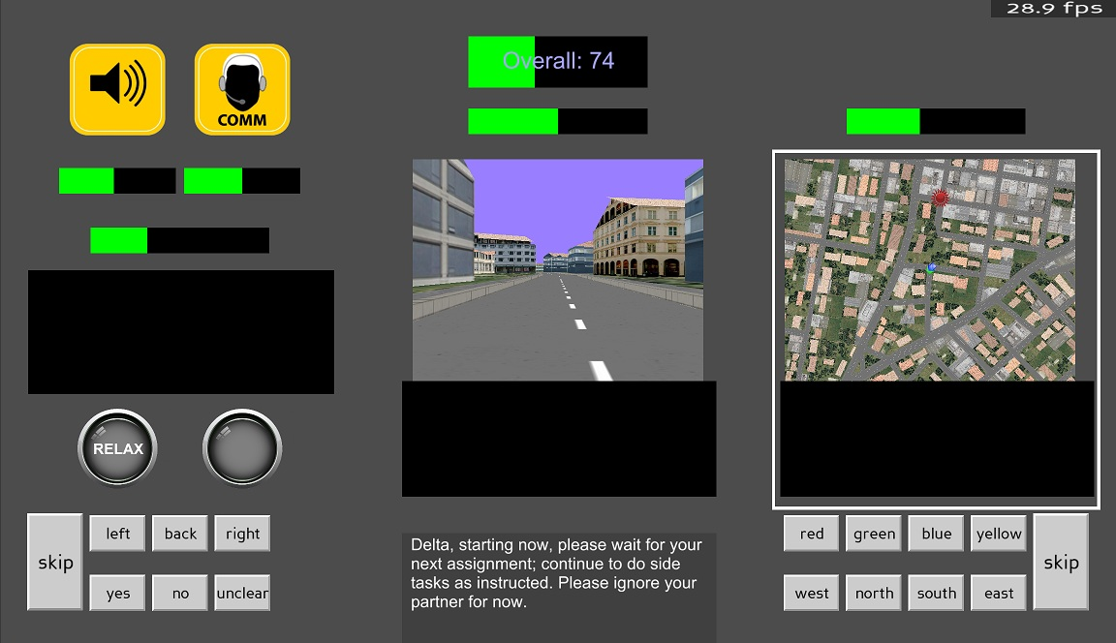
Mission 6 – Waiting for Next Assignment
Notes:
18

Slide 19


Side Tasks
Onscreen buttons OR speaking into the microphone on the table (Y button)
Grounding occurs only on side tasks.
Tip: Make sure to periodically switch between pressing the onscreen buttons and answering through the microphone to avoid a Slap! Penalty sound. ➔
Notes:
19

Slide 20
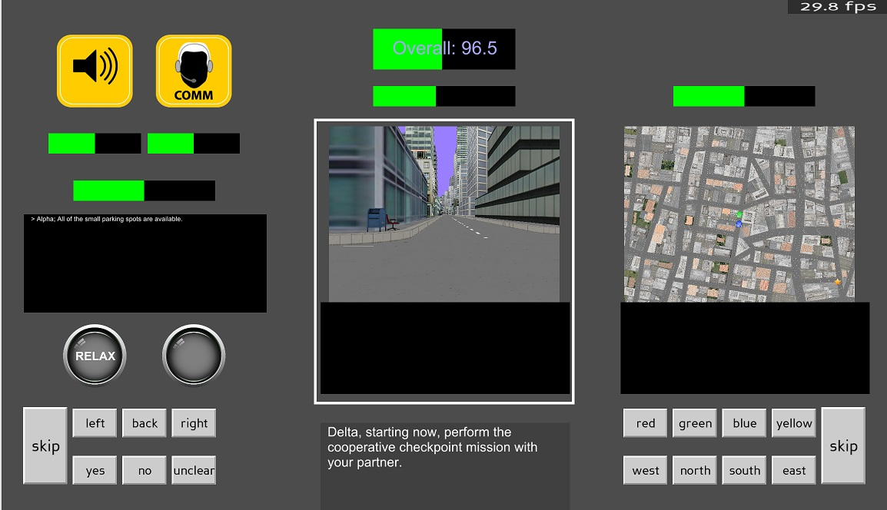
Side Task 1 – Curbside Objects
Trash can on right side.
Notes:
20

Slide 21
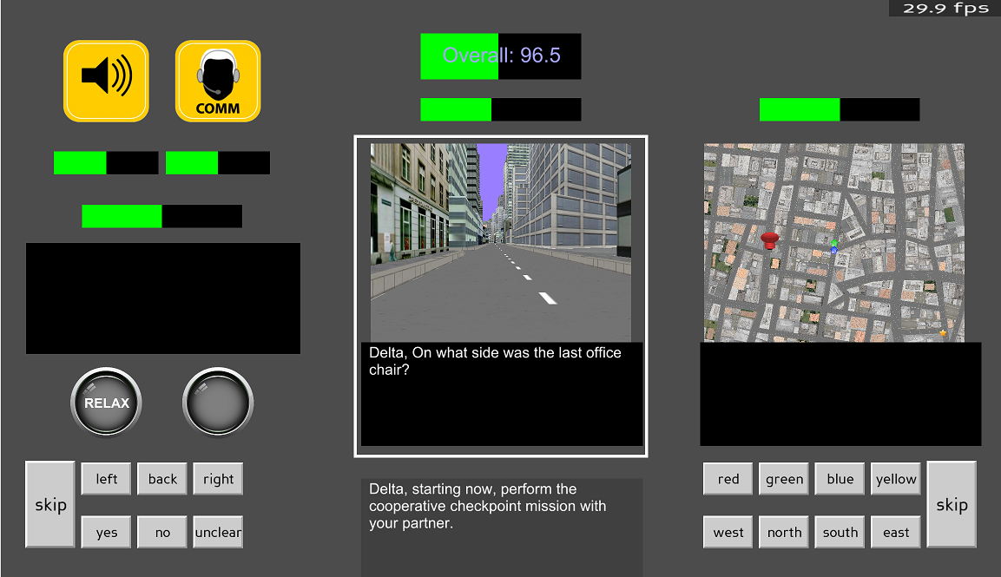
Side Task 1 – Curbside Objects
Question prompt

Slide 22
Side Task 1 – Curbside Objects
Response: Ding! or Buzz!

Slide 23
Side Task 2 – Satellite Map Icons
Icons: Color and direction
Notes:
23

Slide 24
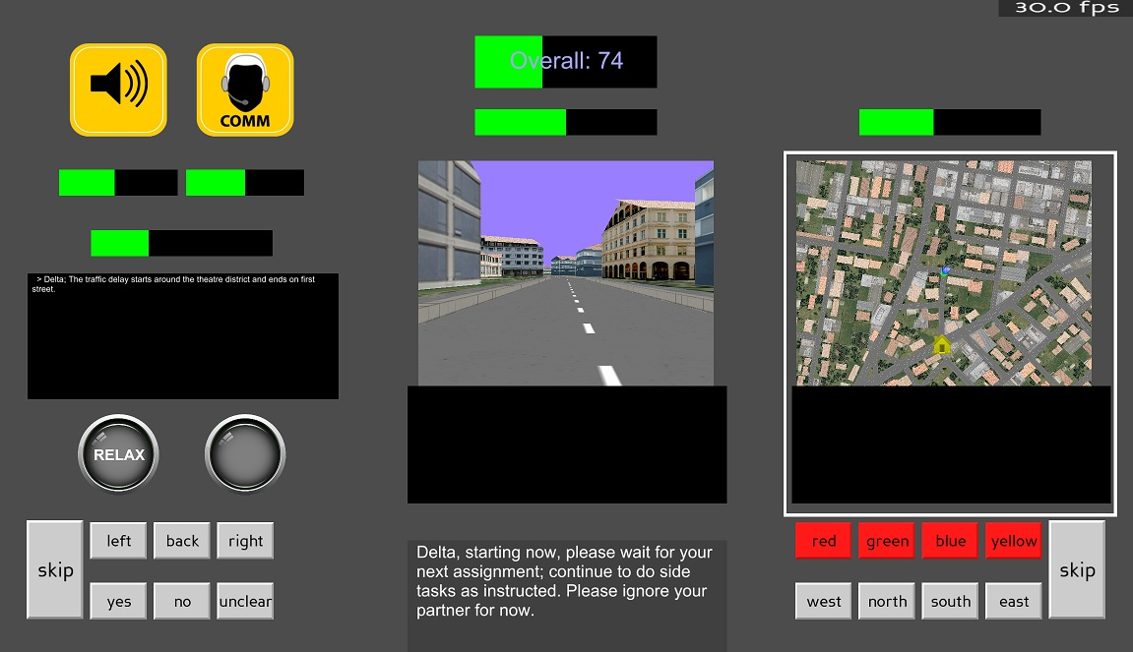
Side Task 2 – Satellite Map Icons
Highlighted prompt

Slide 25
Side Task 2 – Satellite Map Icons
Response: Ding! or Buzz!

Slide 26
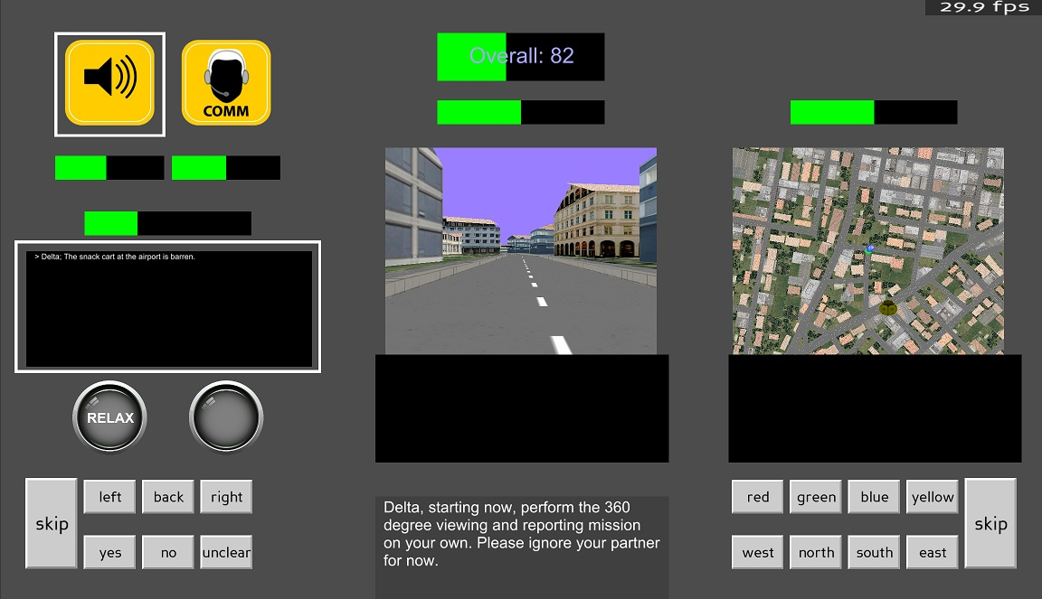
Side Task 3 – Sounds
Sound icon
Notes:
26

Slide 27
Side Task 3 – Sounds
Example Sounds
Child Laughter
Dog Bark
Whoop! sound prompts listener for direction of last sound heard.

Slide 28
Side Task 3 – Sounds
Response: Ding! or Buzz!

Slide 29
Side Task 4 – Spoken Sentences
COMM icon
Tip: Only respond to questions beginning with your code name (Delta or Echo).
Notes:
29

Slide 30
Side Task 4 – Spoken Sentences
Sentence statement
Question about statement
Tip: If you do not hear your call sign (Delta or Echo) then you do NOT have to pay attention.

Slide 31
Side Task 4 – Spoken Sentences
Response: Ding! or Buzz!

Slide 32

Side Task 5 – Written Sentences
Sentence statement
Tip: Only respond to questions beginning with your code name (Delta or Echo).

Slide 33

Side Task 5 – Written Sentences
Question about statement

Slide 34
Side Task 5 – Written Sentences
Response: Ding! or Buzz!

Slide 35
Summary
The actual experiment will take 3 hours to complete.
Accumulated points will determine bonus (up to $40).
Break periods still have the red button alert task.
And remember, have fun with it!

